Slide 1
Marvin K. Peterson Library
Katie + Hannah
Fall 2021
Studio V

Slide 2
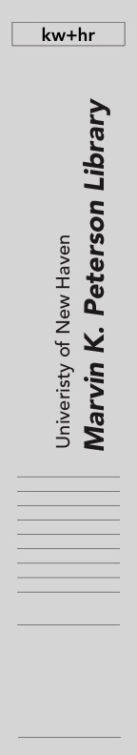
Concept Statement
The University of New Haven is a growing university on the outskirts of downtown New Haven. The Peterson Library is located at the heart of the University in the academic quad. Influencing the design around the symbolic elements of the elm trees, and architectural planning of the city of New Haven will tie the library back to the city roots. Traditionally a library is aimed to be the main intellectual hub on college campuses. However, the Peterson Library has not been designed to support its growing population since it was built in 1970. Incorporating an open floor plan, open seating options, an updated café, and more study rooms for students will help this library better accommodate the students' academic needs. This design will allow students to grow and achieve academically and support this growing university.
Concept Statement
Fall 2021
Studio V
Concept
C.1

Slide 3
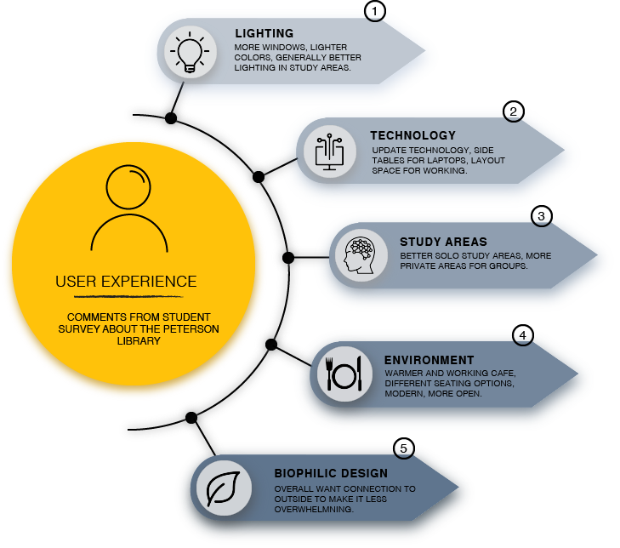
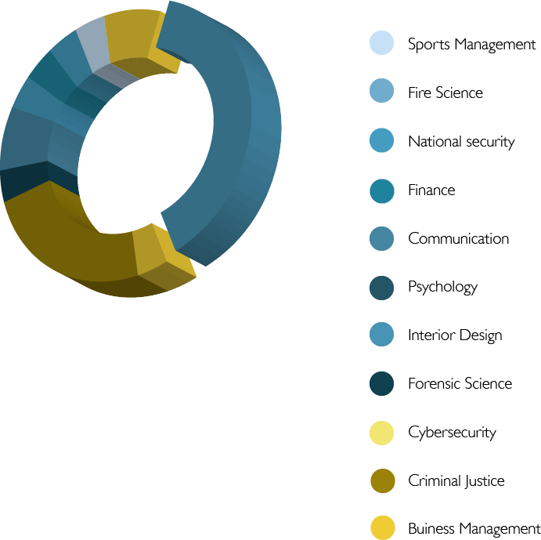
User research
User Experience
Research.
Fall 2021
Studio V
Research

Slide 4
Lower Floor

Slide 5
Furniture Plan
Lower Level
Furniture plan
Fall 2021
Studio V
Floor Plan
A.1
A1
LOWER-LEVEL FURNITURE PLAN
NTS

Slide 6
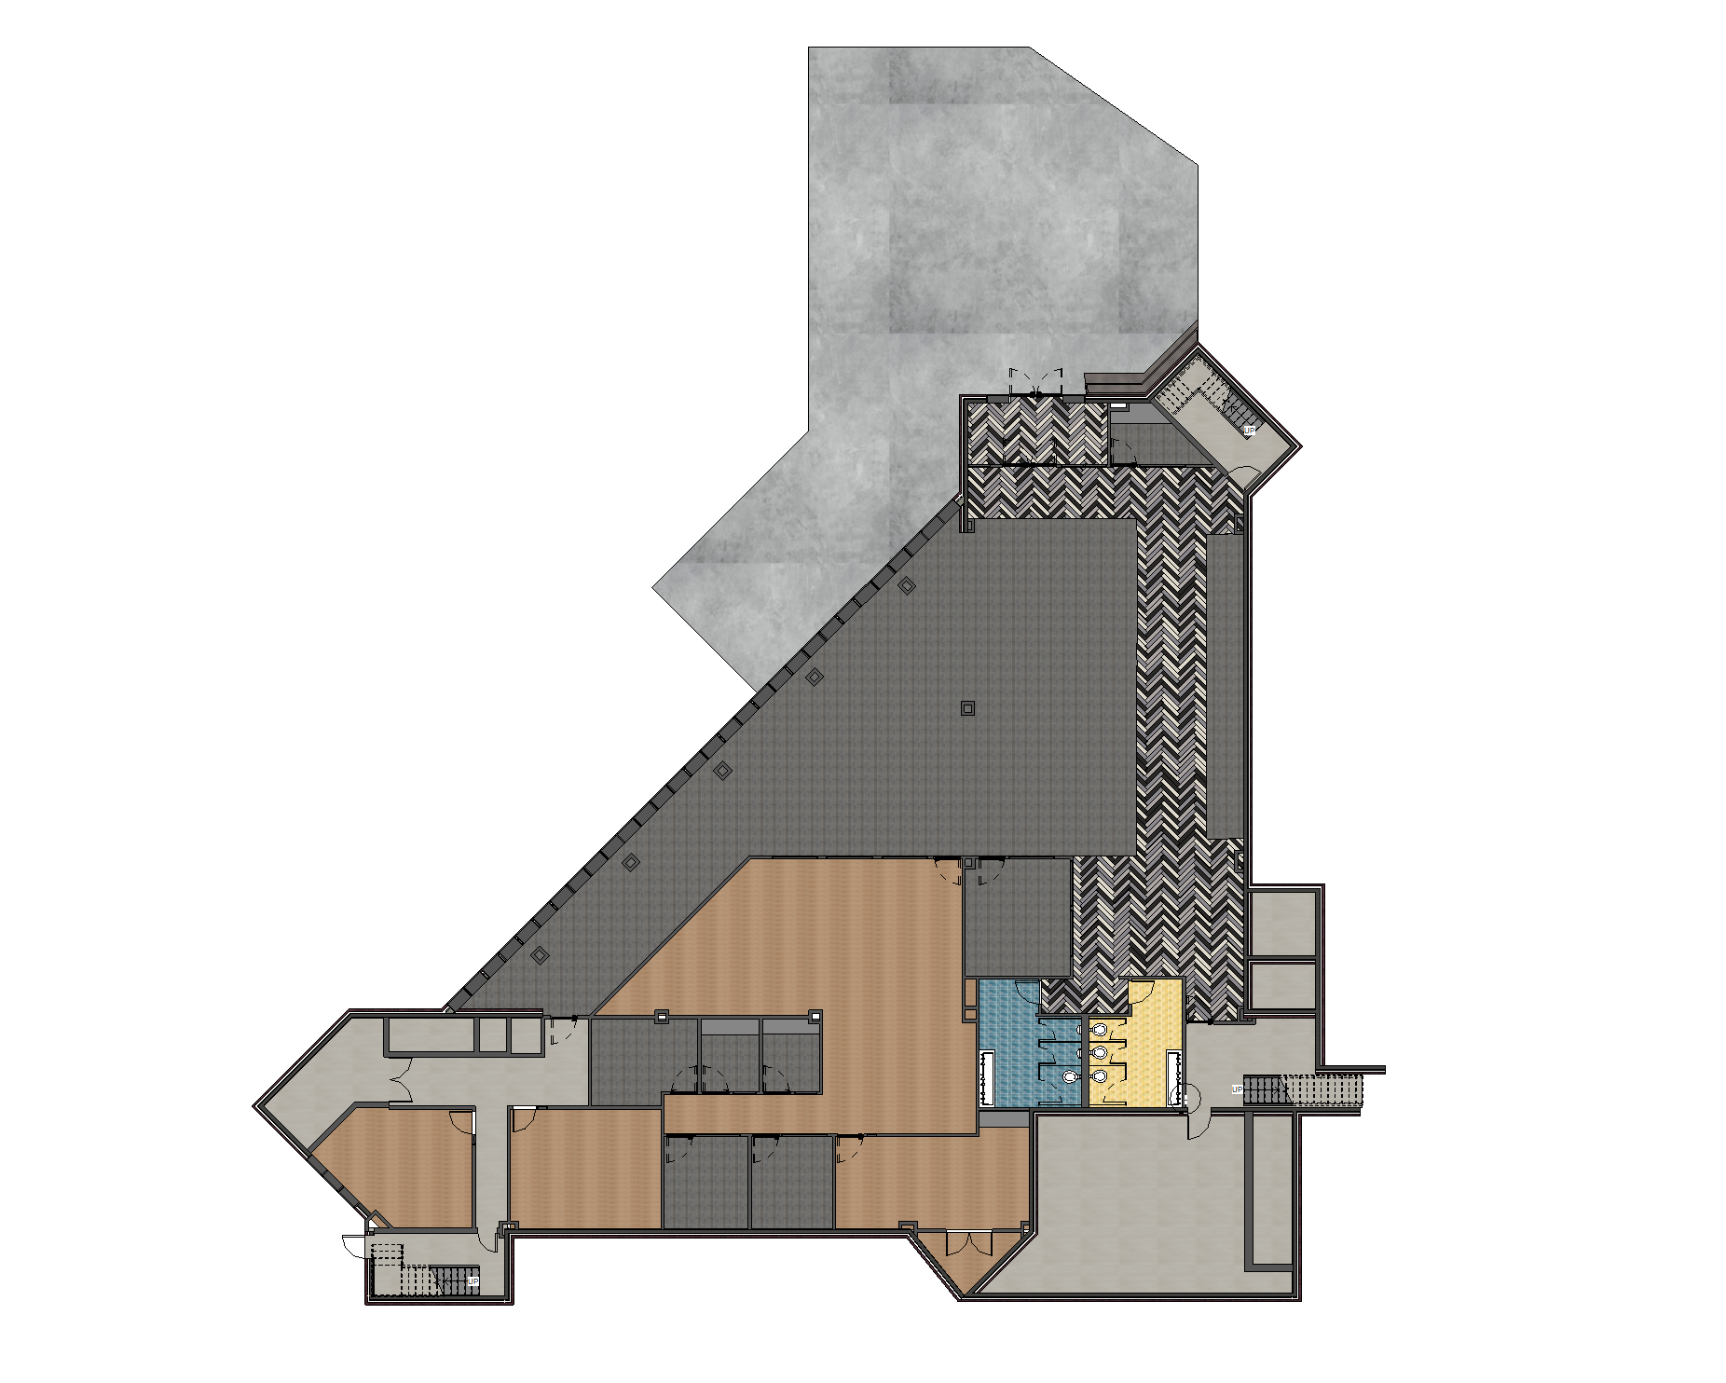
Floor Pattern Plan
Lower Level
Floor Pattern Plan
Fall 2021
Studio V
Floor Plan
A.2
A2
LOWER-LEVEL FLOOR PATTERN PLAN
NTS

Slide 7
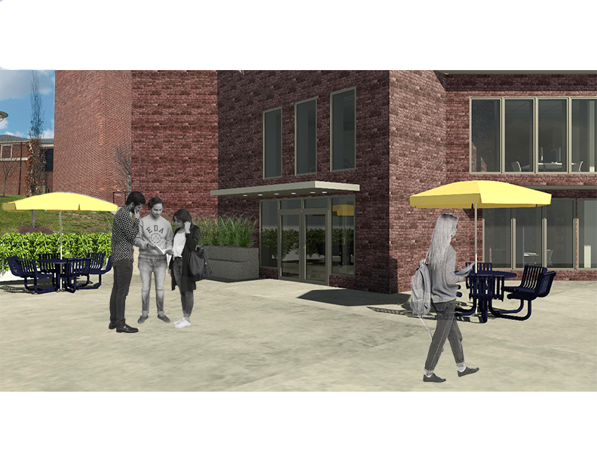
Exterior Rendering
Second Entrance
View
Fall 2021
Studio V
P1
EXTERIOR SECOND ENTRANCE FROM PARKING LOT PERSPECTIVE
Rendering
NTS
P.1

Slide 8
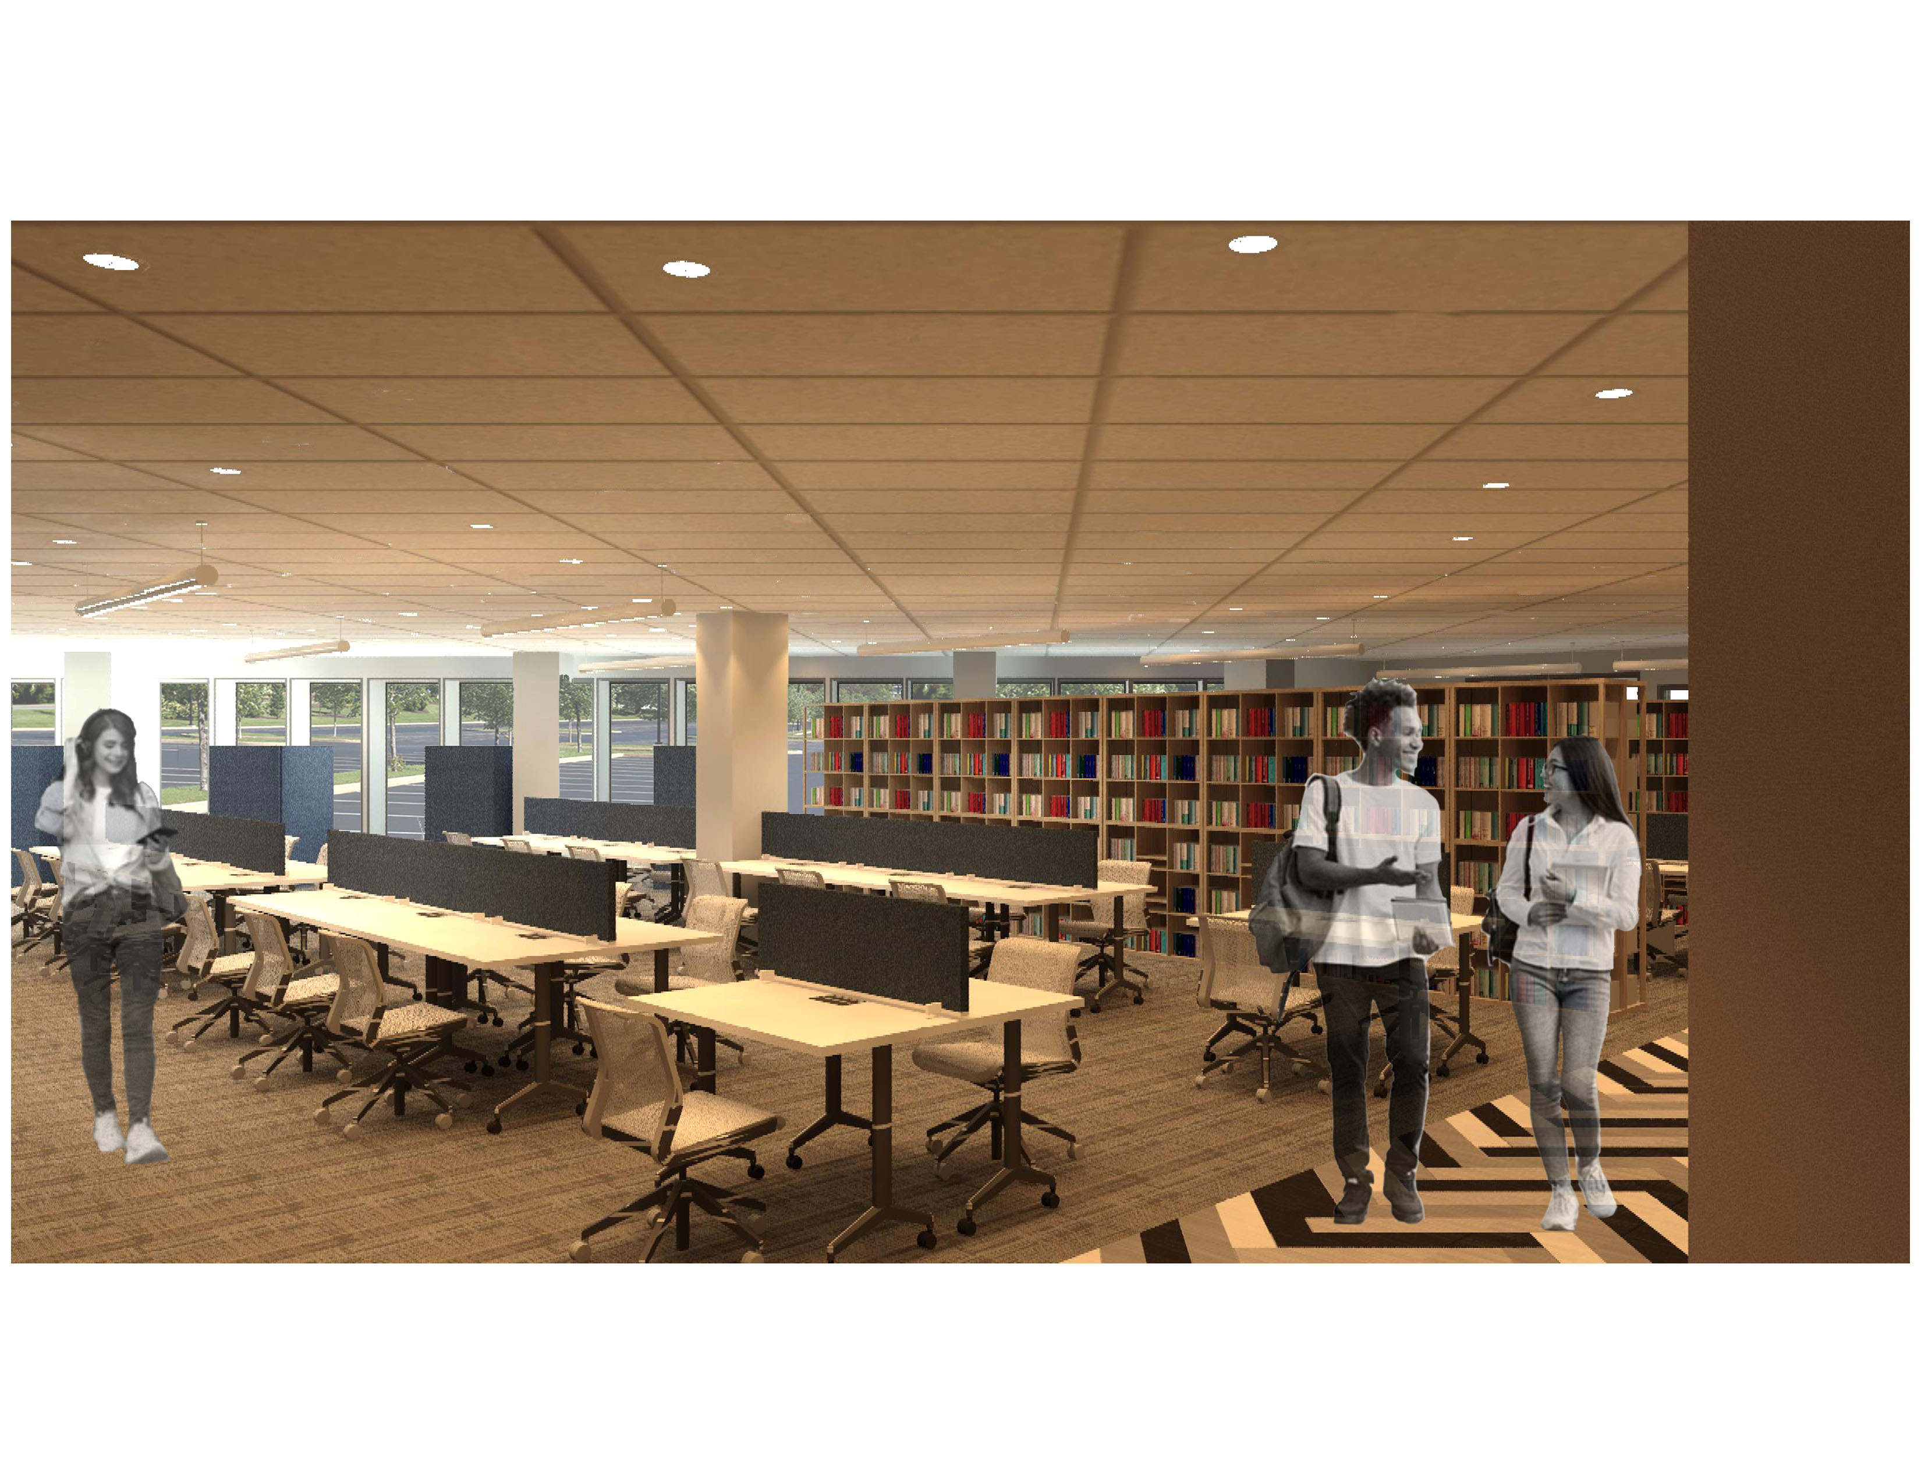
Quiet Floor Rendering
Quiet Floor with
Exterior Window View
Fall 2021
Studio V
P2
QUIET FLOOR PERSPECTIVE
Rendering
NTS
P.2

Slide 9

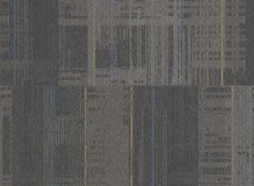




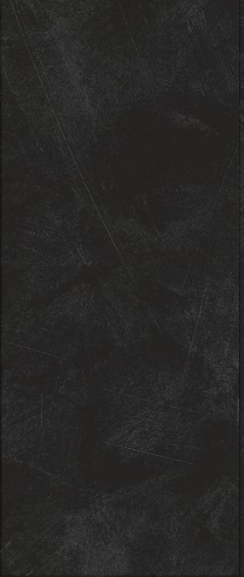
Quiet Floor Finishes
Wall Paint
Carpet Tile
Quiet Floor Finishes
Baseboard
Fall 2021
Studio V
Finishes
Herringbone Floor
F.1

Slide 10
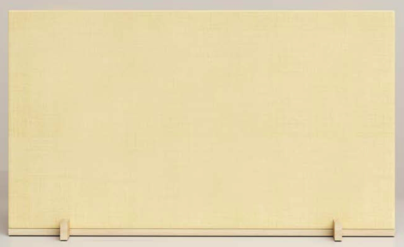
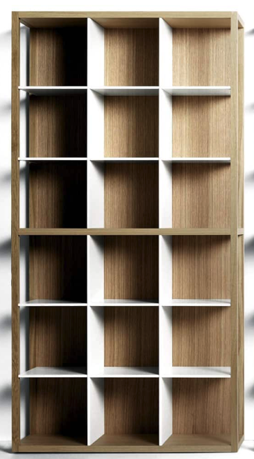


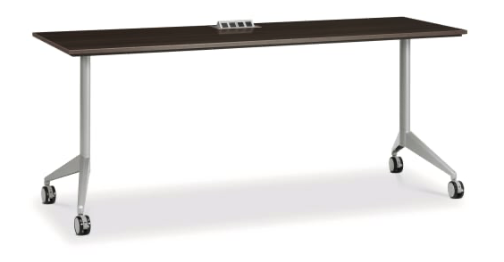

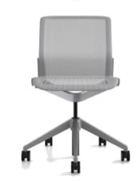


Quiet floor
Felt Upholstery
Acoustics: Table Privacy panel
Laminate
Power Desk
Quiet Floor Private
Workspace Furniture
Metal
Fall 2021
Studio V
Mesh
Furniture
FR.1
Library Stacks
Metal
Task Chair

Slide 11

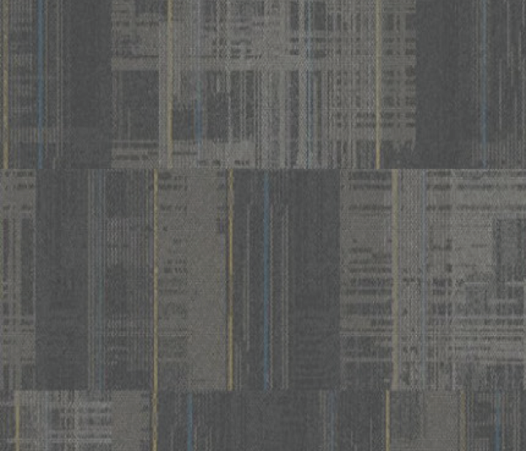


CLR Finishes
Wall Paint
Center for Learning
Resources Main space
+ office Finishes
Baseboard
Fall 2021
Studio V
Porcelain Flooring
Carpet Tile
Finishes
F.2

Slide 12
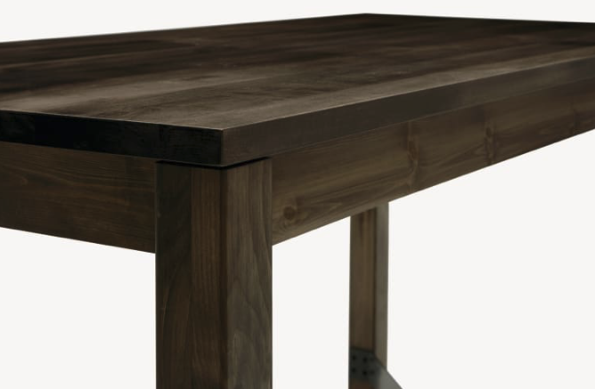
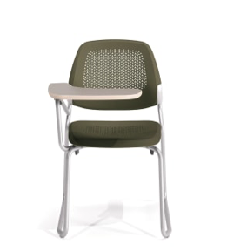
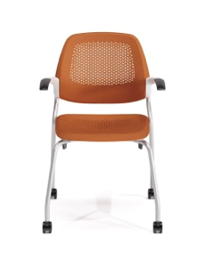

Center for Learning Resources
Laminate
Laminate
Metal
Metal
Power Table
Power Table
Center for learning Resources Furniture
Plastic
Plastic
Fall 2021
Studio V
Furniture
FR.2
Task Chair
Task Chair

Slide 13
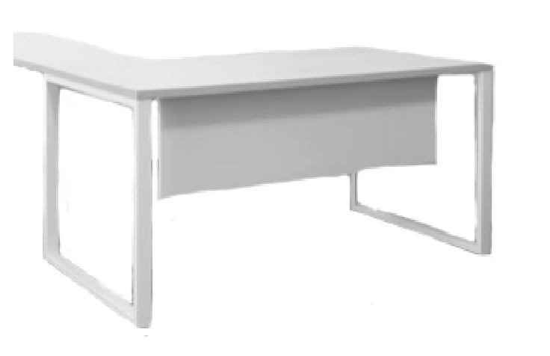

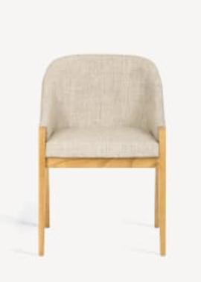
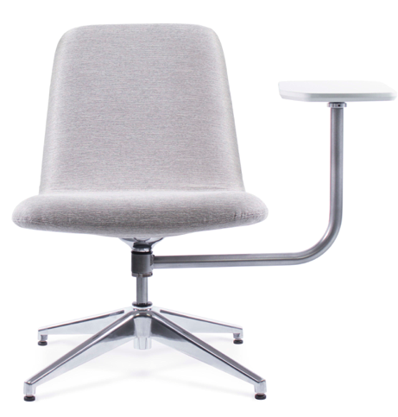





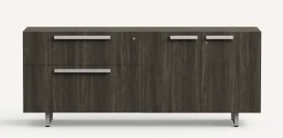
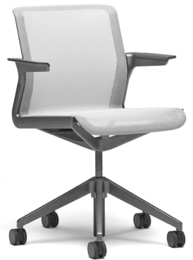
CLR- Study rooms + offices
Upholstery
Wood laminate
Upholstery
Laminate
Metal
Wood
Systems Furniture: Office Desk
Side Chair
Lounge chair with tablet arm
Center for Learning
Resources study
Rooms and offices
Furniture.
Plastic
Wood laminate
Mesh
Fall 2021
Studio V
Systems Furniture: Office Credenza
Furniture
Metal
Metal
Task Chair
FR.3
Task Chair

Slide 14

Study Room Finishes
Wall Paint
Baseboard
Quiet Floor study
Room finishes
Fall 2021
Studio V
Finishes
F.3
Carpet

Slide 15
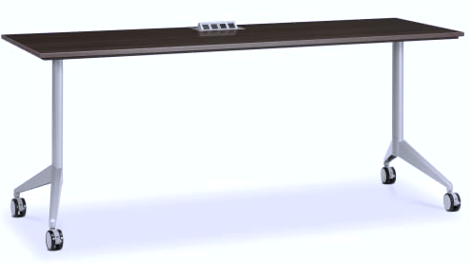
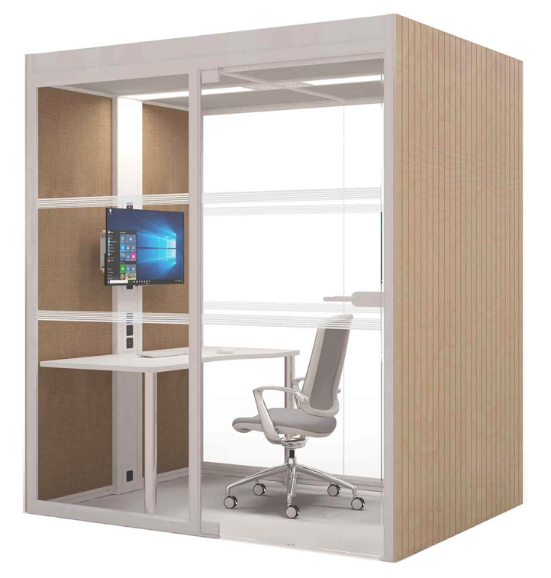

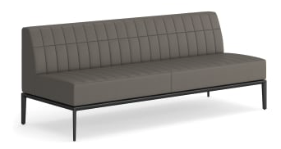





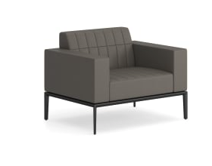
Study Rooms
Upholstery
Laminate
Laminate
Lounge chair with tablet arm
Metal
Power Table
Upholstery
Upholstery
Study Pod
Metal
Lounge: Armless Sofa
Upholstery
Side Seating
Study Room
Furniture
Fall 2021
Upholstery
Mesh
Studio V
Furniture
FR.4
Metal
Metal
Lounge: Club Chair
Task Chair

Slide 16
Main Floor

Slide 17
Furniture Plan
Main Floor Furniture
Plan
Fall 2021
Studio V
Floor Plan
A.3
A3
MAIN LEVEL FURNITURE PLAN
NTS

Slide 18
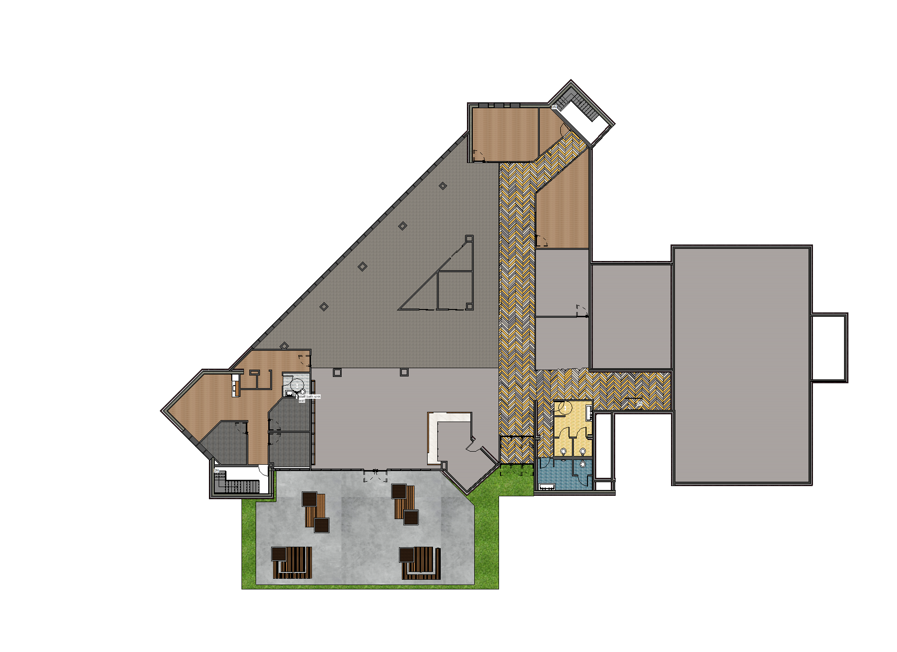
Floor Pattern Plan
Main Floor Patterns
Fall 2021
Studio V
Floor Plan
A.4
A4
MAIN LEVEL FLOOR PATTERN FLOOR PLANS
NTS

Slide 19
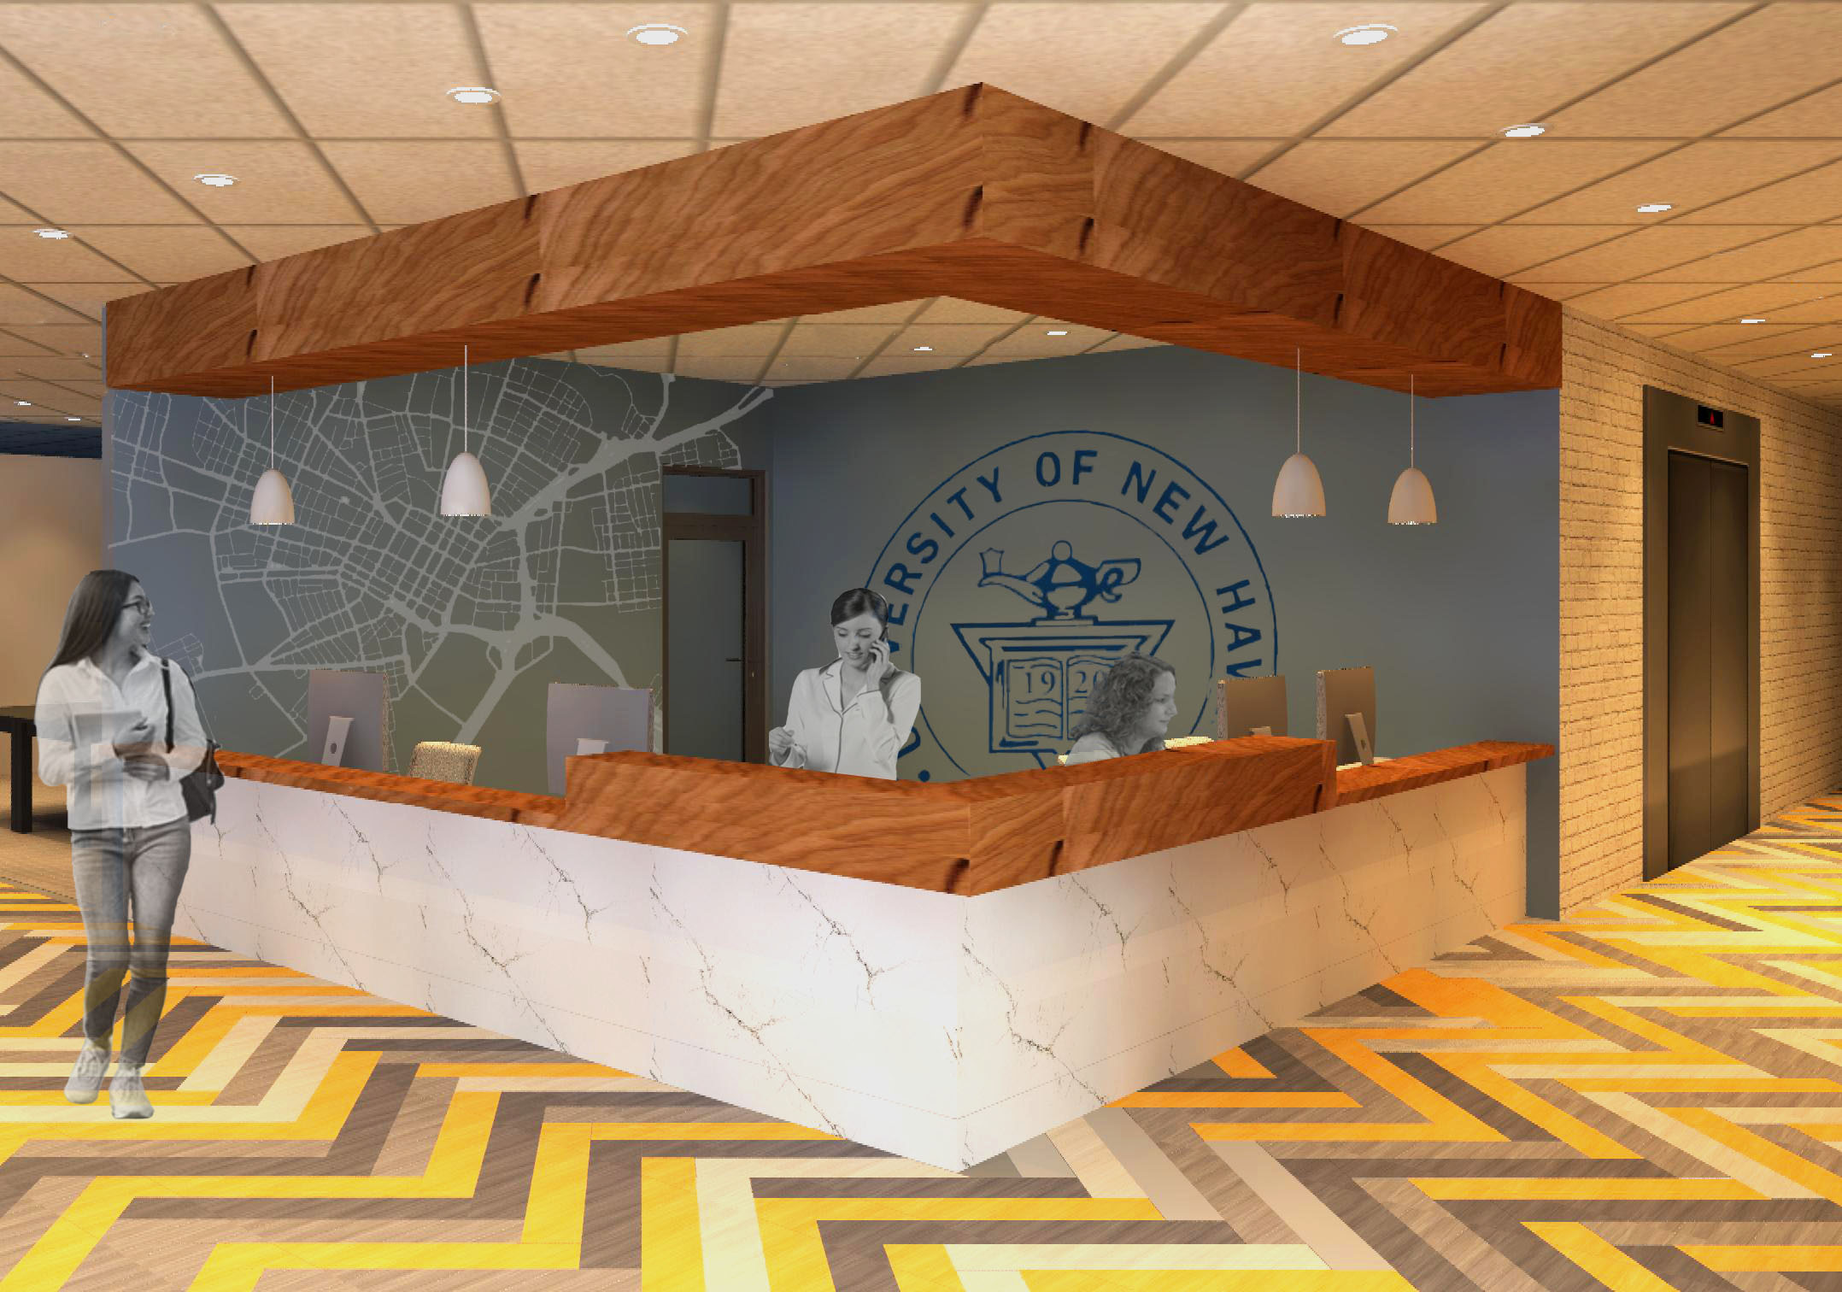
Reception Rendering
Main Floor Reception
View.
Fall 2021
Fall 2021
Studio V
Studio V
Rendering
P3
RECEPTION PERSPECTIVE
P.3
NTS

Slide 20
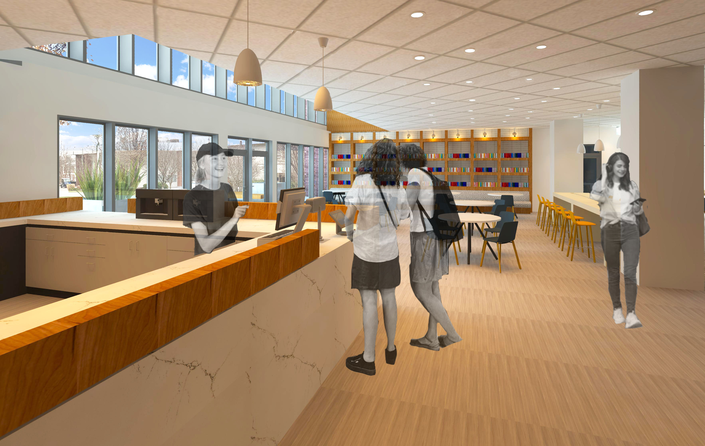
Cafe Rendering
Café + Dining view.
Fall 2021
Fall 2021
Studio V
Studio V
Rendering
P4
Café + Dining Perspective
P.4
NTS

Slide 21
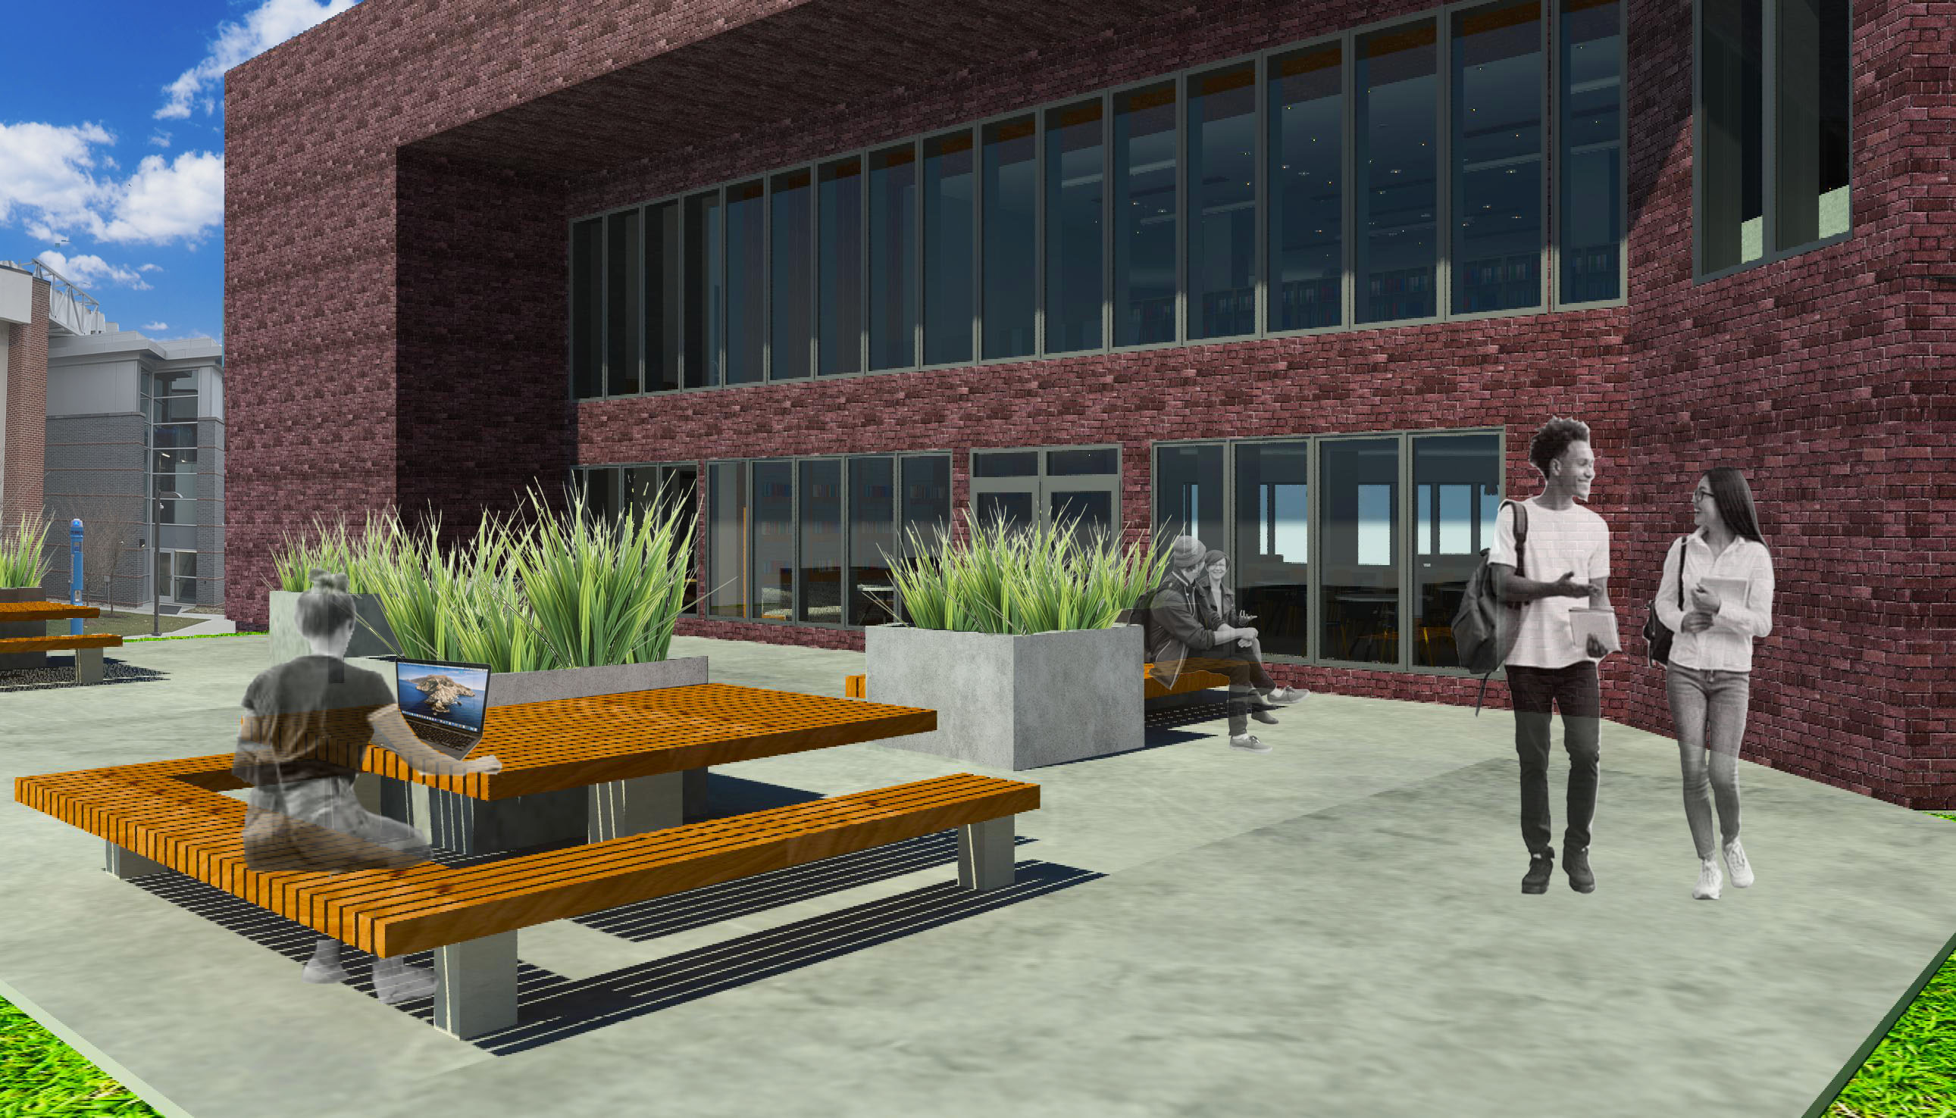
Outdoor Patio Rendering
Outdoor Patio View
Fall 2021
Studio V
Rendering
P3
Outdoor Patio Perspective
P.5
NTS

Slide 22
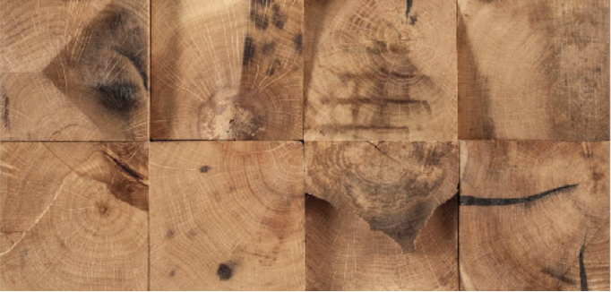





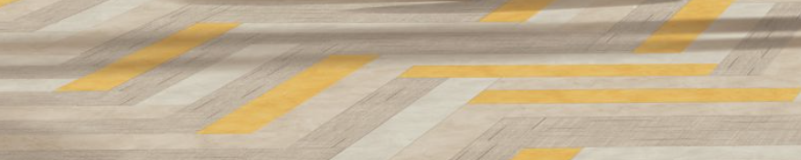

Reception Finishes
Wall Detail
Herringbone Floor
Quartz Countertops
Reception Finishes
Fall 2021
Studio V
Concrete Desk
Finishes
F.4

Slide 23


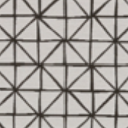



Cafe Finishes
Wall Paint
Quartz Countertops
[Built in] Wood finish
Base Cabinets
Café + Dining Finishes
Baseboard
[Built in] Wall tile
[Built in] Booth Textile
Fall 2021
Studio V
Finishes
F.5
LVT Tile

Slide 24
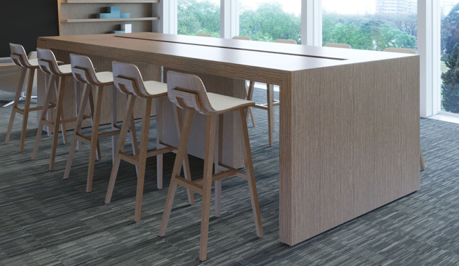
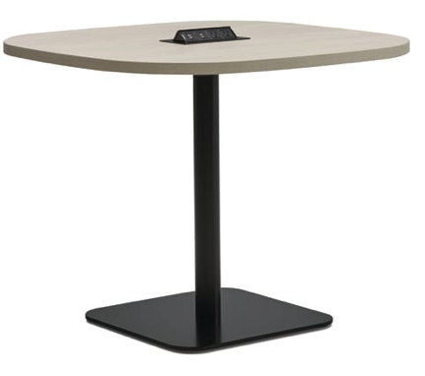
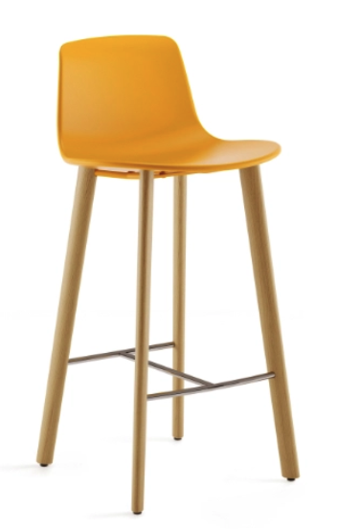
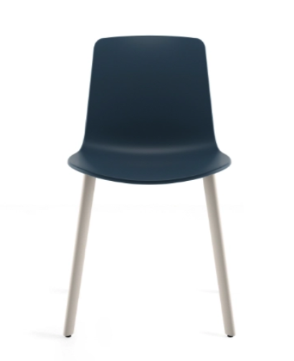
Café
Laminate
Metal
Collaborative table
Power Table
Café + Dining
Furniture
Fall 2021
Studio V
Furniture
FR.5
Café Chair
Café Barstool

Slide 25

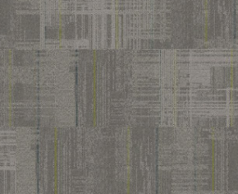
Social Lounge Finishes
Wall Paint
Baseboard
Social Lounge
Finishes
Herringbone Floor
Fall 2021
Studio V
Finishes
F.6
Carpet Tile

Slide 26
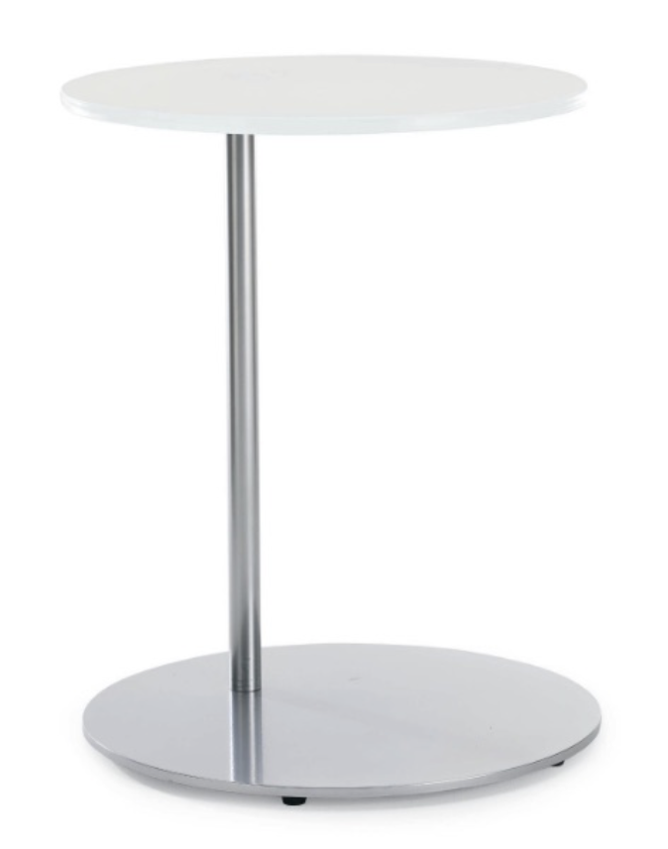
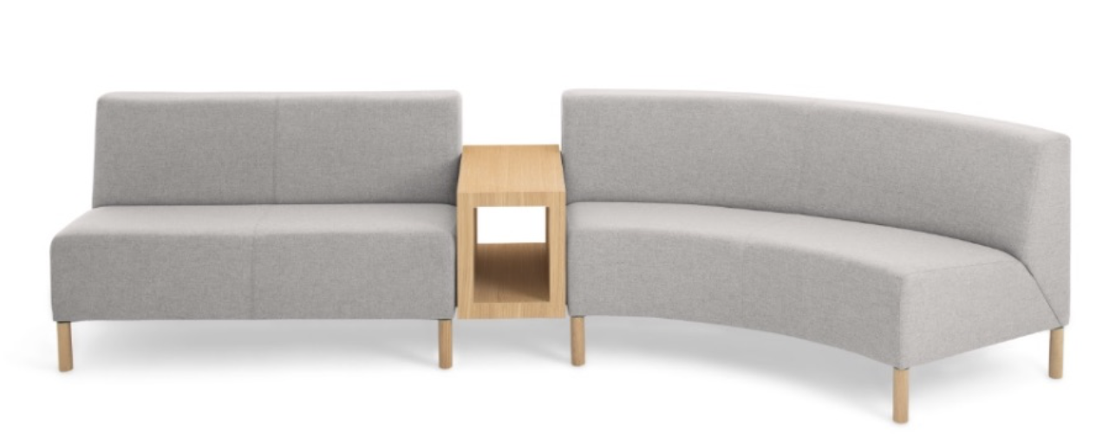

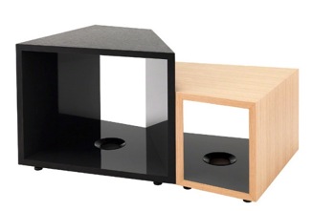


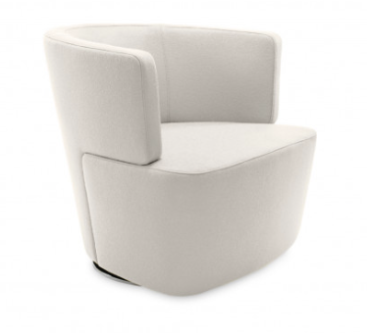

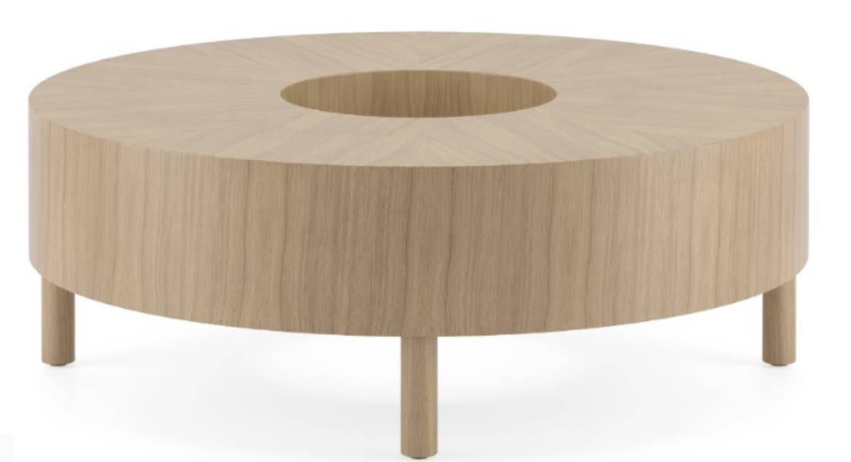
Social Lounge
Side Table
Upholstery
Modular lounge seating
Laminate
Wood
Coffee Table
Social Lounge
Furniture
Upholstery
Fall 2021
Studio V
Furniture
Upholstery
Swivel Chair
Coffee Table
FR.6

Slide 27

Study Rooms + Open Work Area Finishes
Wall Paint
Wall Paint
Baseboard
Baseboard
Study Room and open
Work Finishes
Fall 2021
Studio V
Finishes
F.7
Carpet Tile
Carpet Tile

Slide 28
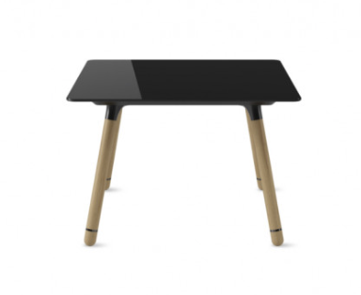

Open Work Area + Study Room
Felt Upholstery
Collaborative table
Acoustics: Table Privacy panel
Glass
Laminate
Wood
Metal
Power Table
Worktable
Social Work Lounge
Furniture.
Upholstery
Mesh
Fall 2021
Studio V
Furniture
Metal
FR.6
Laminate
Lounge chair with tablet arm – study rooms
Task Chair
Work Chair
Work Barstool

Slide 29
Writing Center Finishes
Wall Paint
Writing Center
Finishes
Baseboard
Fall 2021
Studio V
Finishes
Porcelain Flooring
F.6

Slide 30
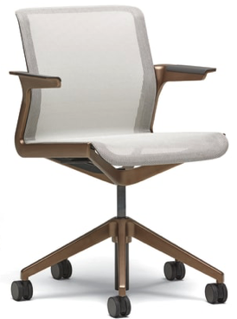
Writing Center
Wood Laminate
Laminate
Metal
Reception Desk
Metal
Power Table
Writing center
furniture
Upholstery
Mesh
Plastic
Fall 2021
Studio V
Rendering
FR.7
Wood
Side Chair
Metal
Reception Chair
Task Chair

Slide 31



Office Finishes
Wall Paint
Terrazzo Countertops
Office Finishes
Cabinetry
Baseboard
Fall 2021
Studio V
Finishes
Porcelain Flooring
F.7

Slide 32
Offices
Wood laminate
Mesh
Metal
Metal
Task Chair
Systems Furniture: Office Desk
Office Furniture
Wood laminate
Upholstery
Fall 2021
Studio V
Metal
Systems Furniture: Office Credenza
Furniture
Side Chair
Wood
FR.8

Slide 33
Upper Floor

Slide 34
Furniture Plan
Upper Floor Furniture
Plan
Fall 2021
Studio V
Floor Plan
A5
UPPER FLOOR FURNITURE PLAN
A.5
NTS

Slide 35
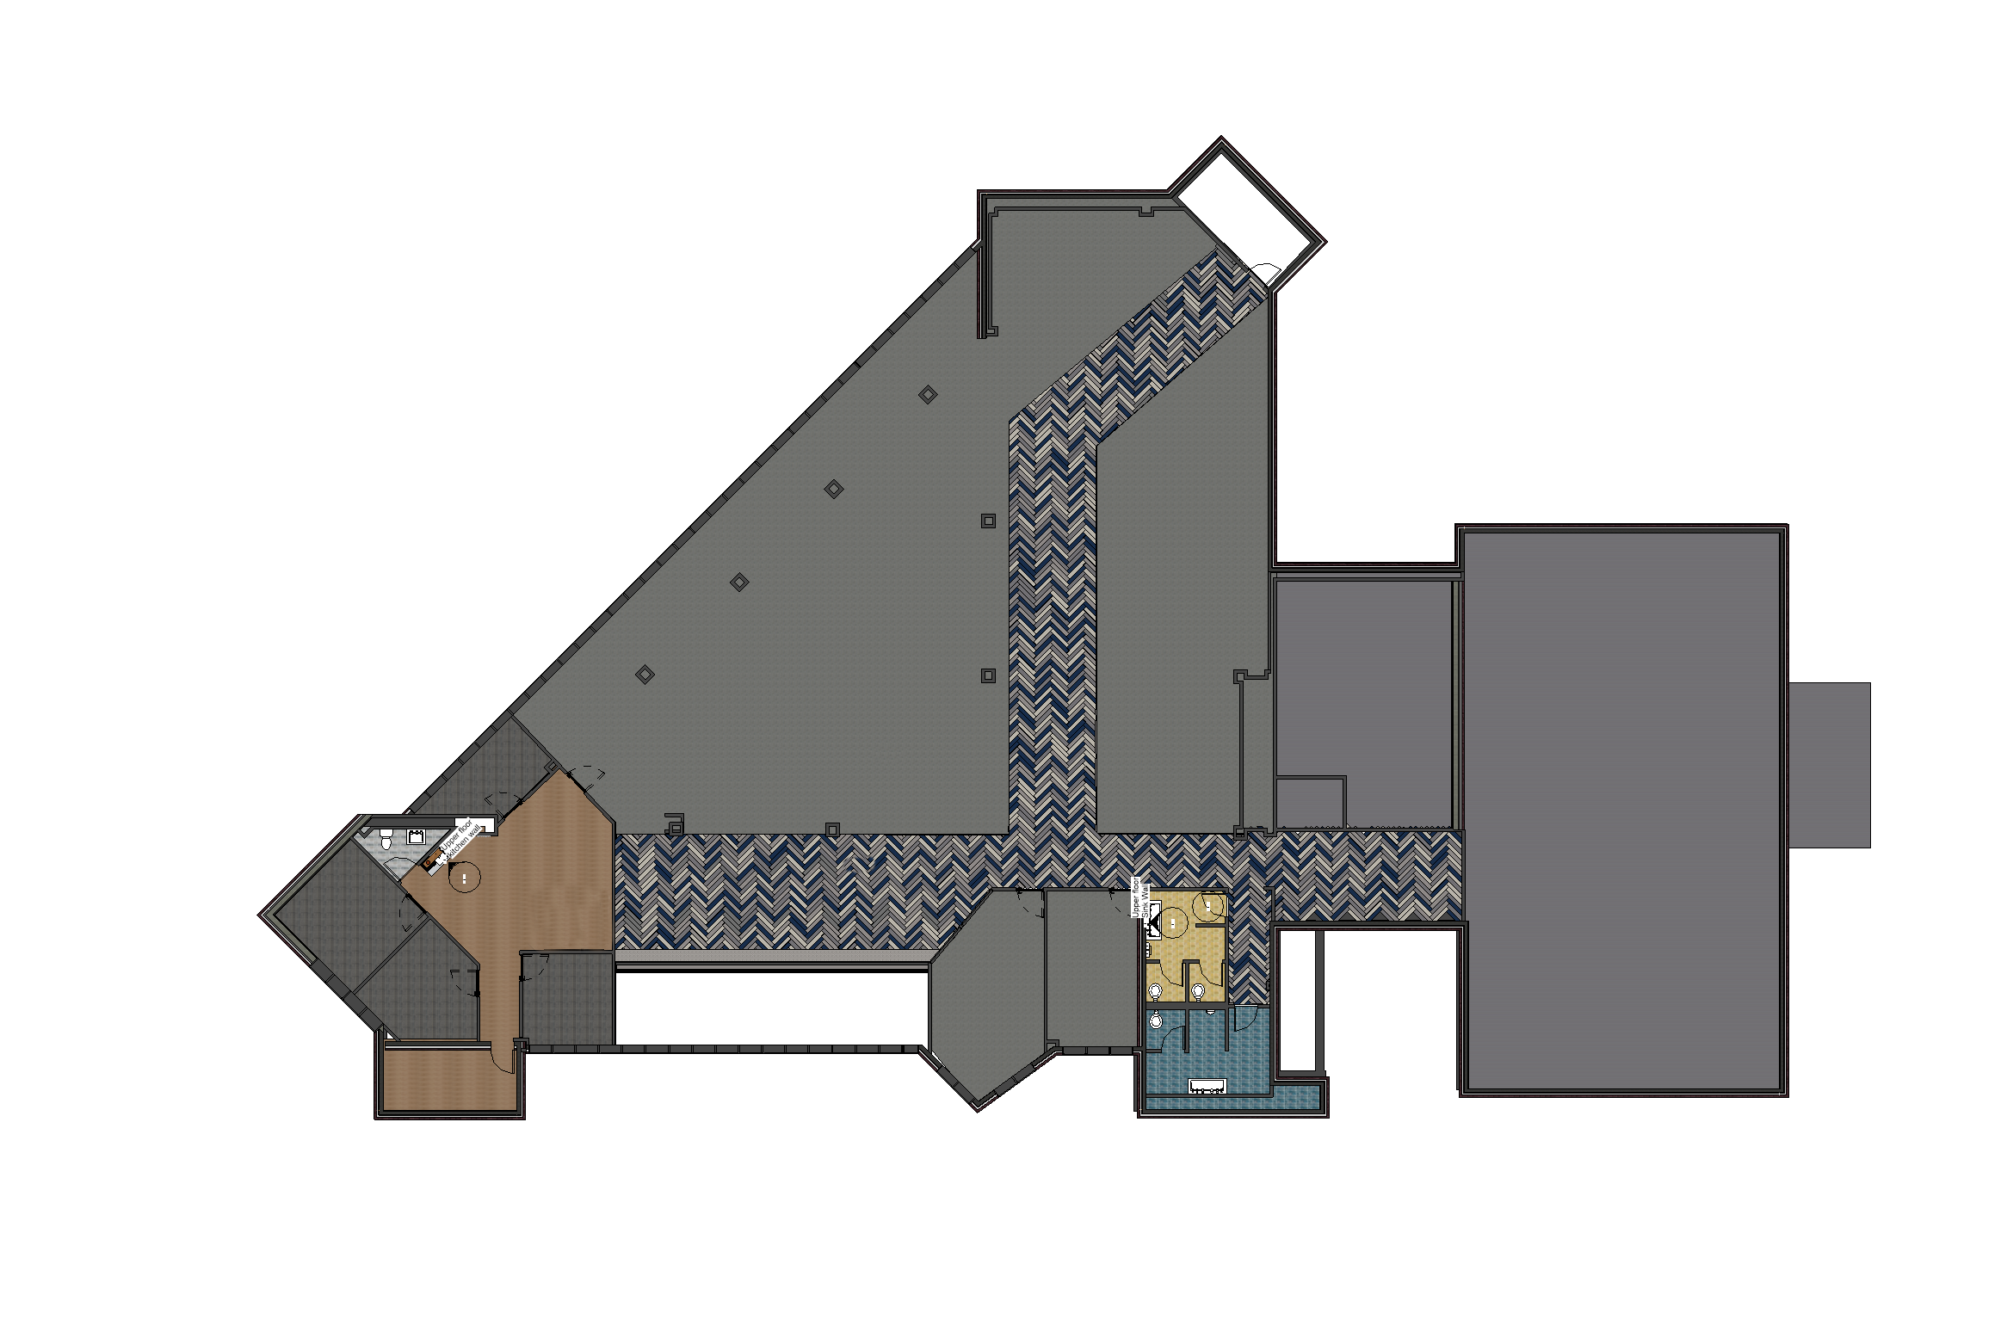
Floor Pattern Plan
Upper Floor Furniture
Plan
Fall 2021
Studio V
Floor Plan
A6
UPPER FLOOR PATTERNS PLAN
A.6
NTS

Slide 36
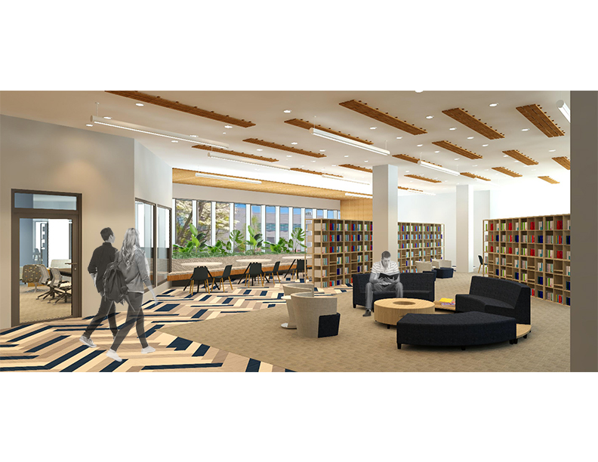
Lounge Rendering
Upper Social Lounge
View.
Fall 2021
Fall 2021
Studio V
Studio V
Rendering
P6
UPPER FLOOR SOCIAL LOUNGE PERSPECTIVE
P.6
NTS

Slide 37
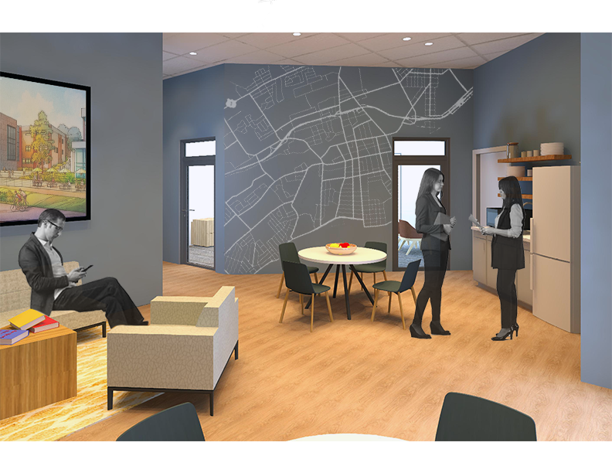
Office Rendering
Upper Floor Office
Staff lounge view
Fall 2021
Fall 2021
Studio V
Studio V
Rendering
P.7
P7
UPPER FLOOR STAFF BREAKROOM + OFFICES
NTS

Slide 38
Kitchenette Elevation
Upper Staff Lounge
Kitchenette Elevation.
Fall 2021
Fall 2021
Studio V
Studio V
Elevation
E.1
E1
UPPER FLOOR STAFF BREAK ROOM KITCHEN
NTS

Slide 39
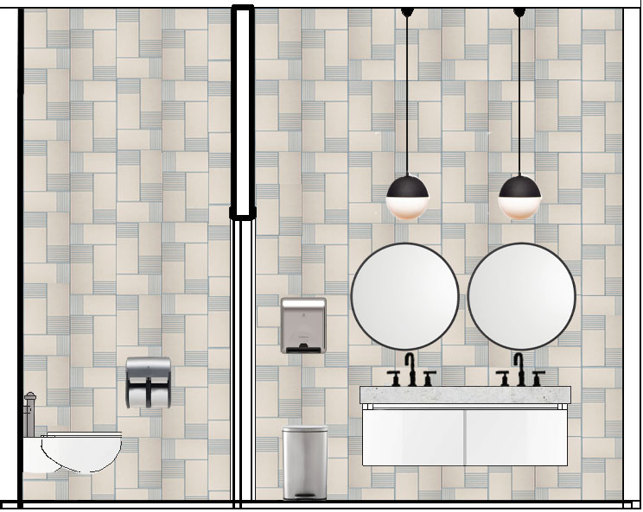
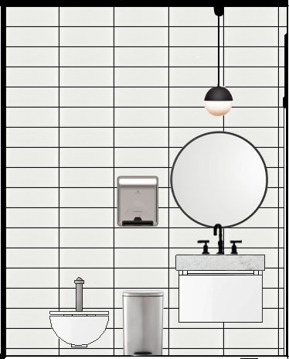
Bathroom Elevations
Staff and Public
Bathroom Elevation.
Fall 2021
Fall 2021
Studio V
UPPER FLOOR PUBLIC WOMENS RESTROOM SINK WALL
Studio V
E2
E3
MAIN LEVEL STAFF BATH SINK WALL
NTS
NTS
Elevation
E.2

Slide 40


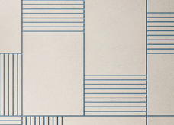







Bathroom Finishes
Public Restrooms
Staff Restrooms
Ceiling Paint
Ceiling Paint
Partitions
Wall Mounted Sinks
Wall Tile
Wall Tile
Wall Mounted Sinks
Public and Staff
Bathroom finishes.
Fall 2021
Fall 2021
Studio V
Studio V
Finishes
F.8
Men's Bathroom Flooring
Women's Bathroom Flooring
Bathroom Flooring

Slide 41



Lounge + Open Work Area Finishes
Wall Paint
Baseboard
Lounge and open
Work Area finishes.
Herringbone Floor
Fall 2021
Studio V
Finishes
Carpet Tile
F.9

Slide 42
Lounge Area
Side Table
Upholstery
Modular lounge seating
laminate
Metal
Power Table
Upper Social Lounge
Furniture.
Coffee Table
Upholstery
Fall 2021
Laminate
Studio V
Furniture
Upholstery
FR.9
Laminate
Coffee Table
Swivel Chair
Work Chair

Slide 43
Open Work Area
Felt Upholstery
Acoustics: Table Privacy panel
Collaborative table
Laminate
Metal
Power Table
Public and Staff
Bathroom finishes.
Glass
Wood
Mesh
Fall 2021
Studio V
Worktable
Furniture
Metal
FR.10
Task Chair
Work Chair

Slide 44
Study Room Finishes
Wall Paint
Baseboard
Upper Floor study room Finishes.
Fall 2021
Studio V
Carpet Tile
Finishes
F.10

Slide 45
Study Rooms
Laminate
Upholstery
Laminate
Coffee Table
Metal
Lounge: Club Chair
Lounge: Armless Sofa
Upholstery
Laminate
Metal
Metal
Upper Floor Study
Room furniture.
Upholstery
Power Table
Fall 2021
Studio V
Plastic
Furniture
FR.11
Laminate
Lounge chair with tablet arm
Task Chair

Slide 46




Office Finishes
Staff Lounge
Wall Paint
Wall Paint
Terrazzo Countertops
Baseboard
Upper Staff Office
Finishes.
Cabinetry
Baseboard
Fall 2021
Studio V
Finishes
Carpet Tile
F.11
Porcelain Flooring

Slide 47
Staff Offices + Lounge
Wood laminate
Mesh
Metal
Systems Furniture: Office Desk
Metal
Laminate
Task Chair
Metal
Power Table
Wood laminate
Upholstery
Upper Staff Office
Furniture
Metal
Systems Furniture: Office Credenza
Wood
Side Chair
Fall 2021
Studio V
Upholstery
Upholstery
Furniture
FR.12
Lounge: Club Chair
Metal
Metal
Lounge: Armless Sofa
Work Chair

Slide 48
End.

